Slide 1
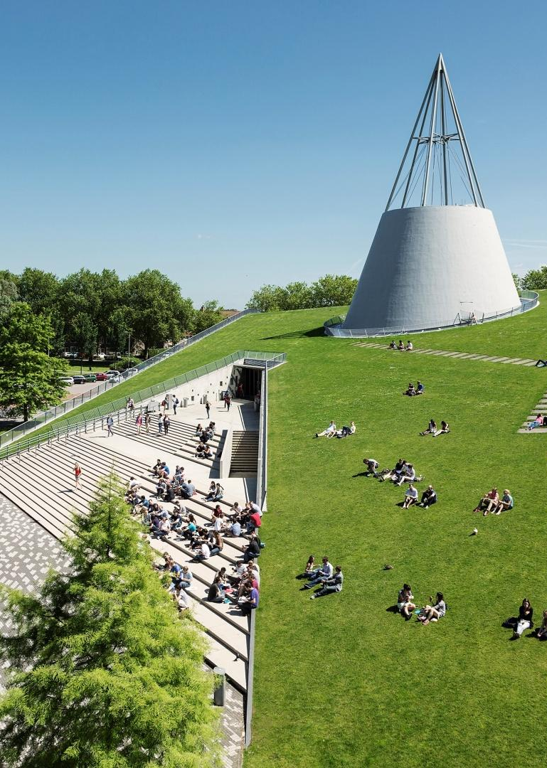
Title slide + image
3D imaging in vitro embryos
Mikel Zwarthoed, Luuk Gooijer, Malina Matricala, Andrei Ionita, Yoan Popov, Traian Dobrin

Slide 2
Agenda
CREATE/EDIT A HYPERLINK TO A SLIDE
1
Go to the tab ‘Insert’ and click on the button ‘Shapes’. Choose the shape ‘Rectangle’ and drag the mouse over the slide to create a shape.
Shapes
2
Drag the shape over the menu button and scale the shape as large as the button. Click with the right mouse button on the shape and choose ‘Edit shape’.
Size and position…
Edit shape…
3
Click on the paint bucket icon, click on ‘Shape Fill’ and drag the ‘Transparency’ slider to 100%. Now the shape is completely transparent.
01
02
03
04
05
Introduction
Methodology / Algorithm design
Results
Discussion
Q&A
Transparency
100%
4
Click on the transparent shape and use the shortcut Ctrl + K to add a hyperlink. At the left side of the window, click on ‘Place in this document’ and select the preferred slide in the list. Then click on ‘OK’.
5
Copy the transparent shape and repeat step 4. Do this for all menu buttons.
WANT TO KNOW MORE? Go to the tab 'SLIDEBUILDER’ and click on the button ‘INSPIRATION'
Inspiration

Slide 3
Chapter | dark mode
Introduction
01

Slide 4
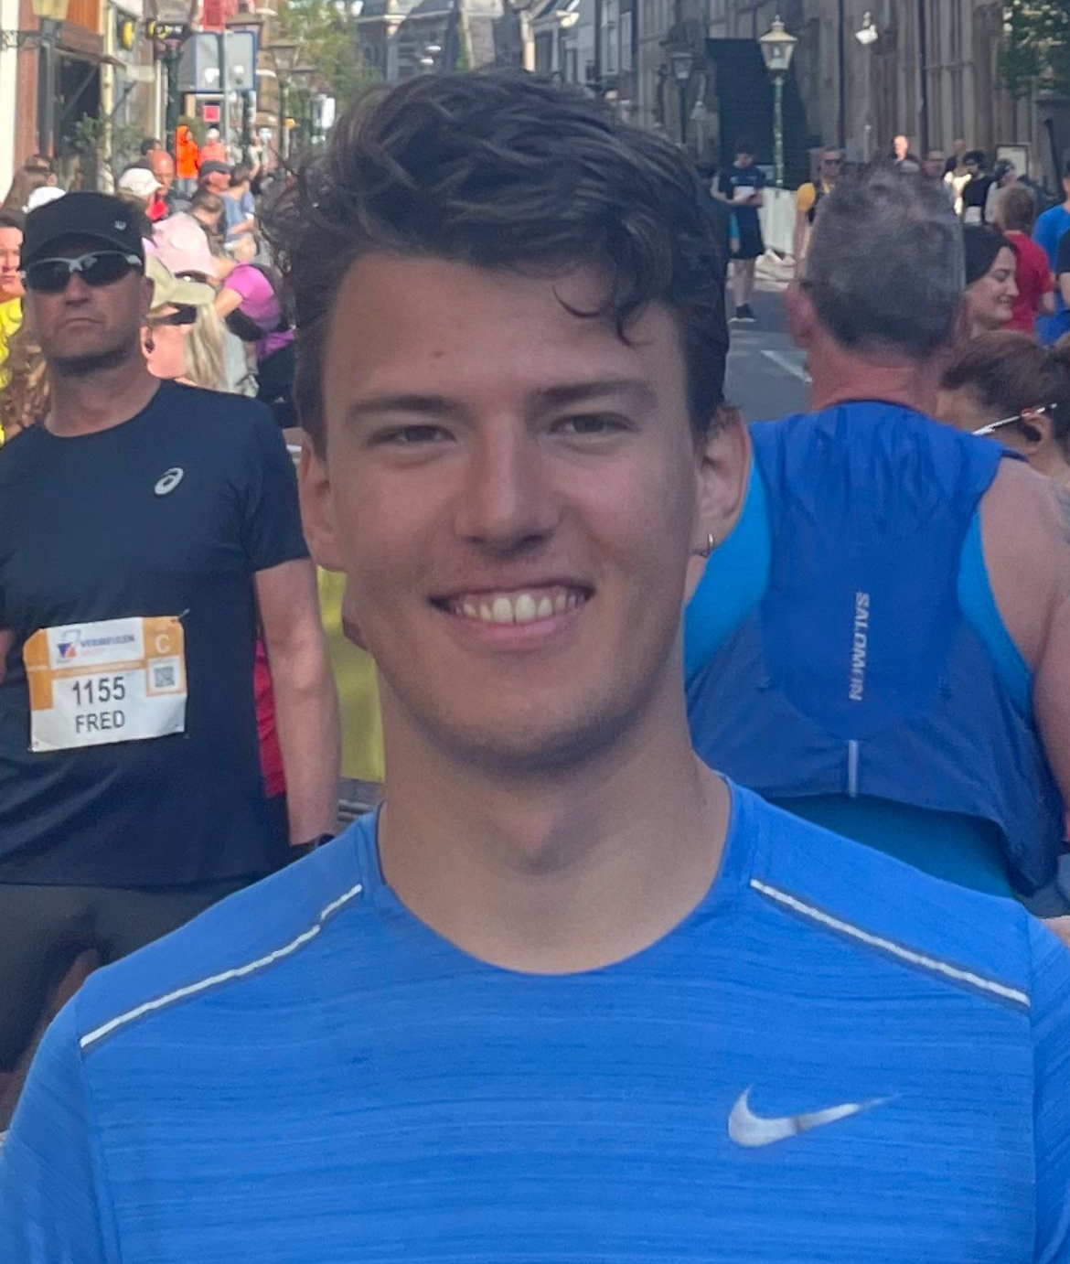
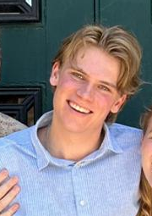
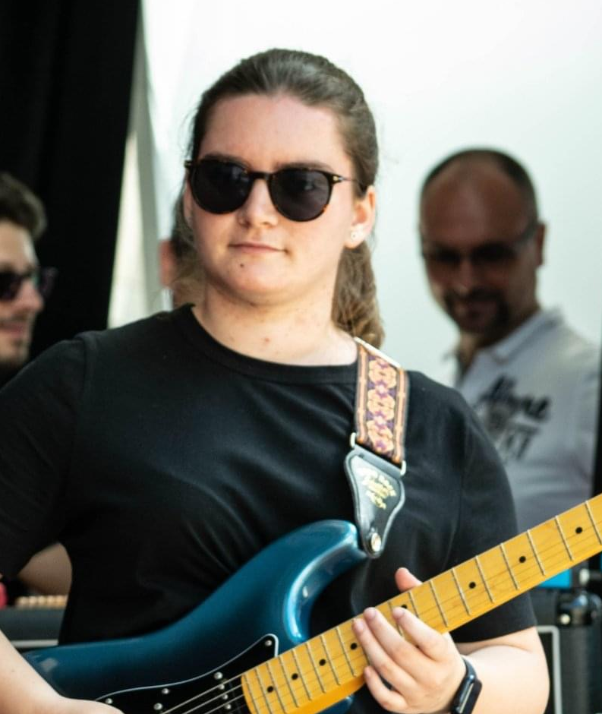
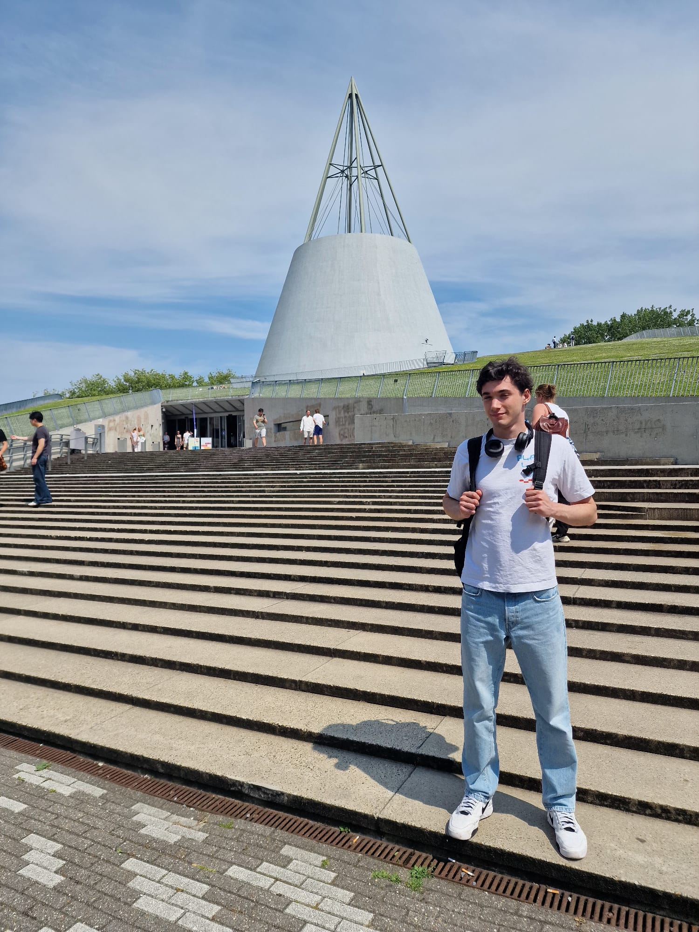

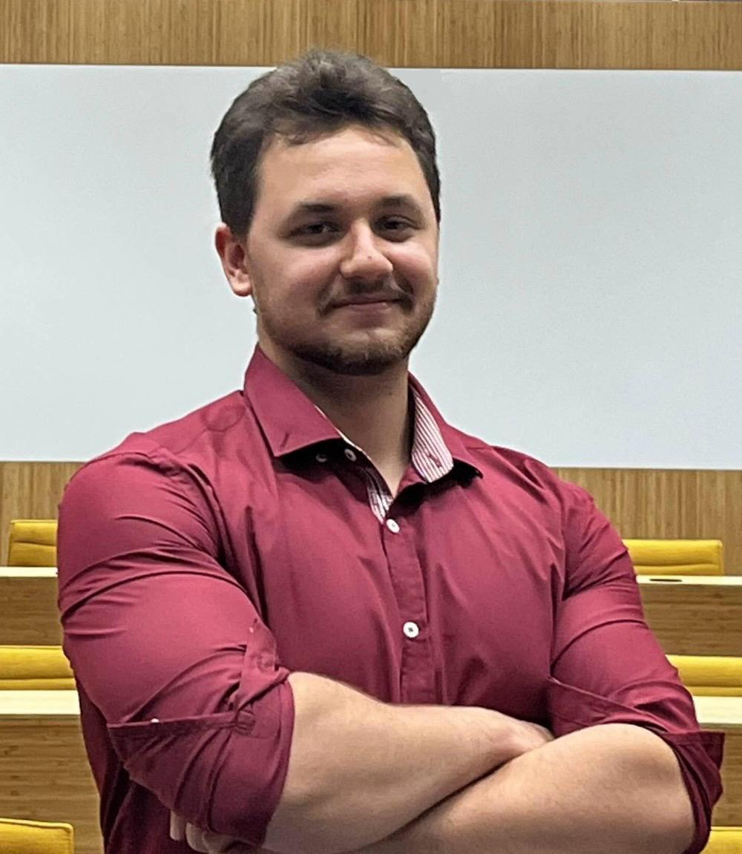
About us
Mikel Zwarthoed
Luuk Gooijer
Malina Matricala
Mechanical Engineering
Mechanical Engineering
Nanobiology
Andrei Ionita
Yoan Popov
Traian Dobrin
Computer Science and Engineering
Computer Science and Engineering
Computer Science and Engineering

Slide 5
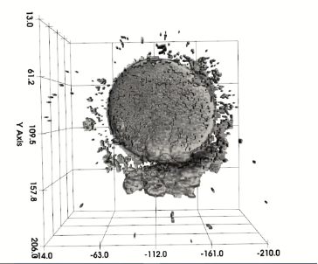
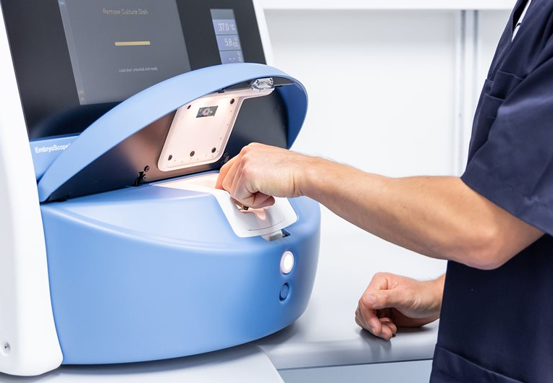

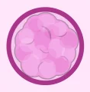
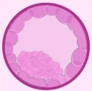
Introduction
01
zygote
morula
blastocyst
EmbryoScopeTM
Developmental stages of embryo
Goal of this study
A time-lapse incubator capturing high-resolution embryo images
Embryos progress through distinct stages over 5-6 days
Develop a computational method for 3D embryo reconstruction to improve viability assessment

Slide 6
Chapter | dark mode
Methodology/ Algorithm Design
02

Slide 7
What kind?
Evaluation?
Deterministic
As unsupervised as possible
Metrics for mathematical justification
Eye tests

Slide 8
What kind?
Evaluation?
Deterministic
As unsupervised as possible
Metrics for mathematical justification
Eye tests

Slide 9
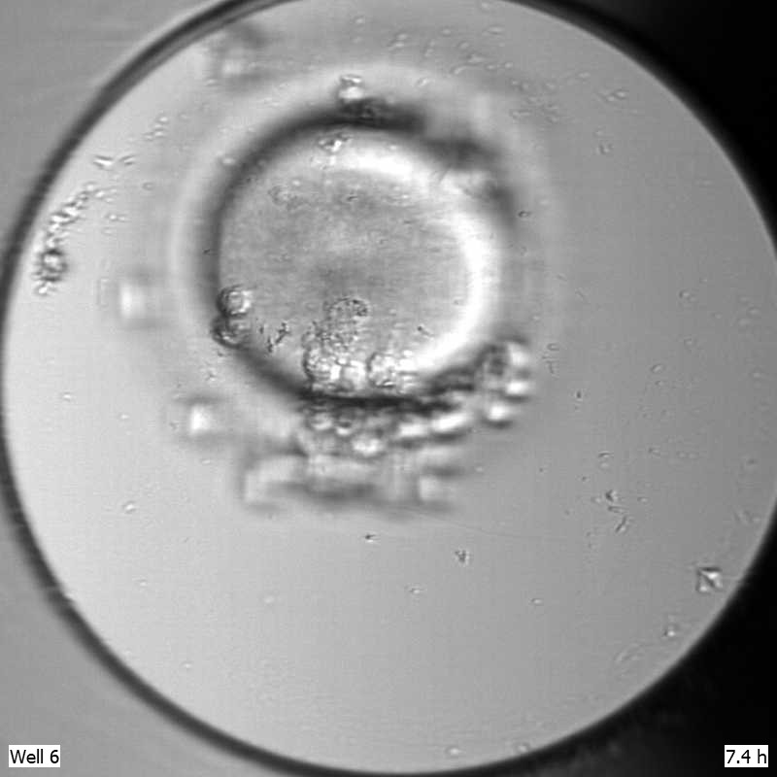
Chapter | colour mode
02
What is the data?
A lot of 2D images
Resolution: 3 px per µm
11 equidistant focal planes
Follows first 5 days of development
Reference image, 1 focal plane

Slide 10
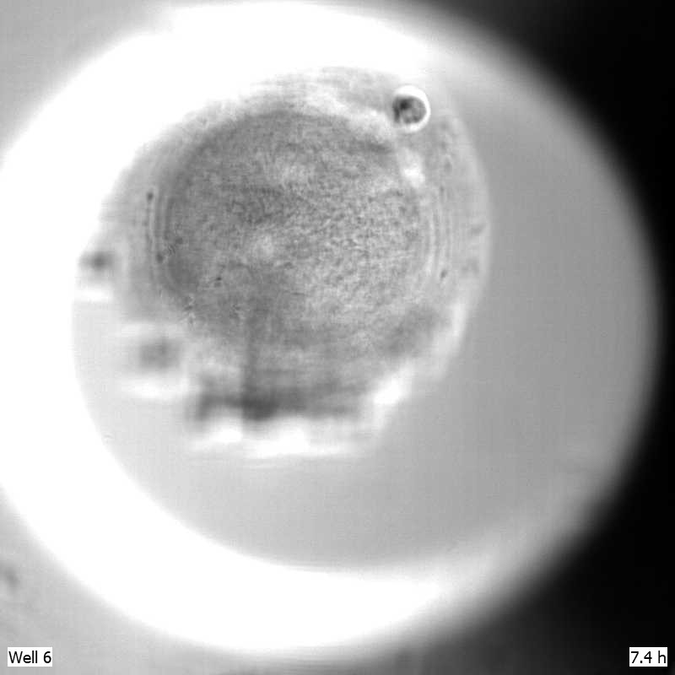
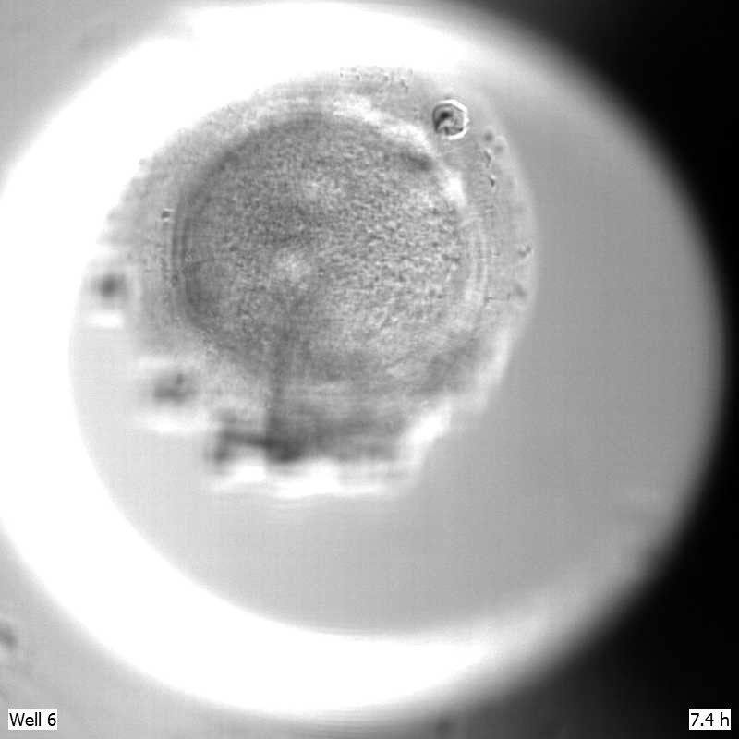
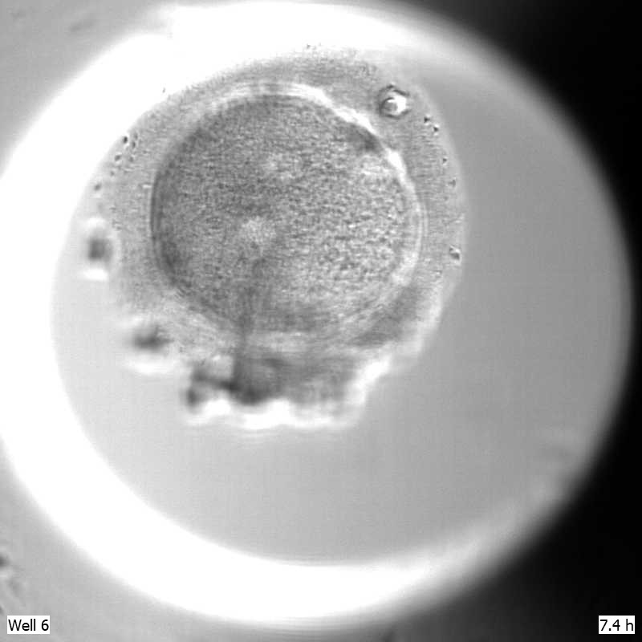

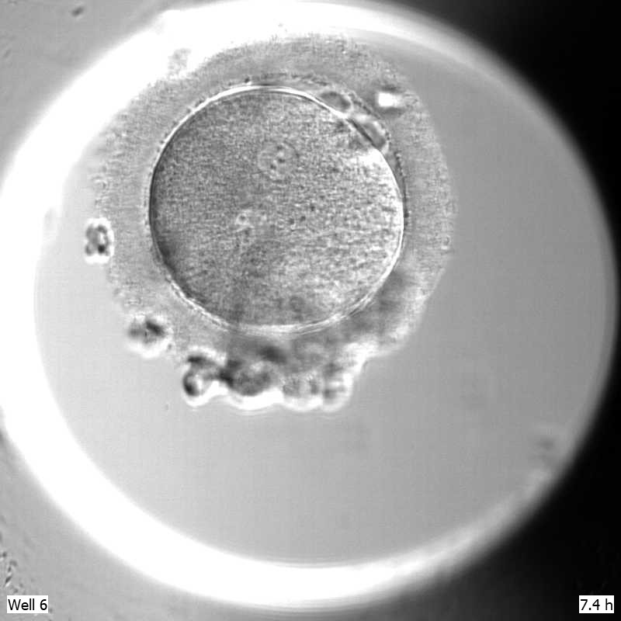

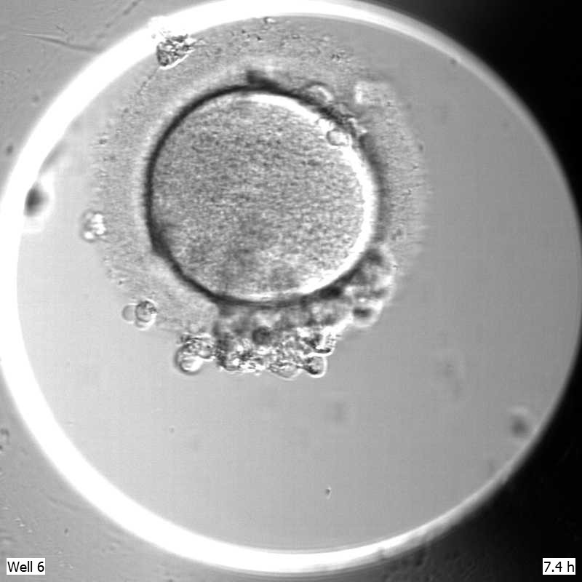
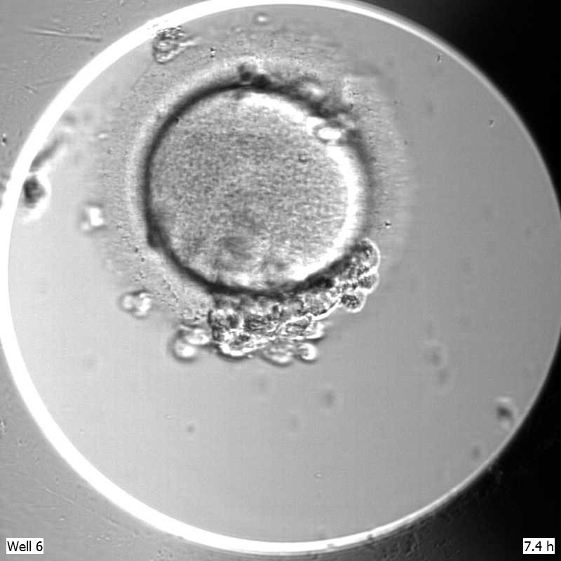
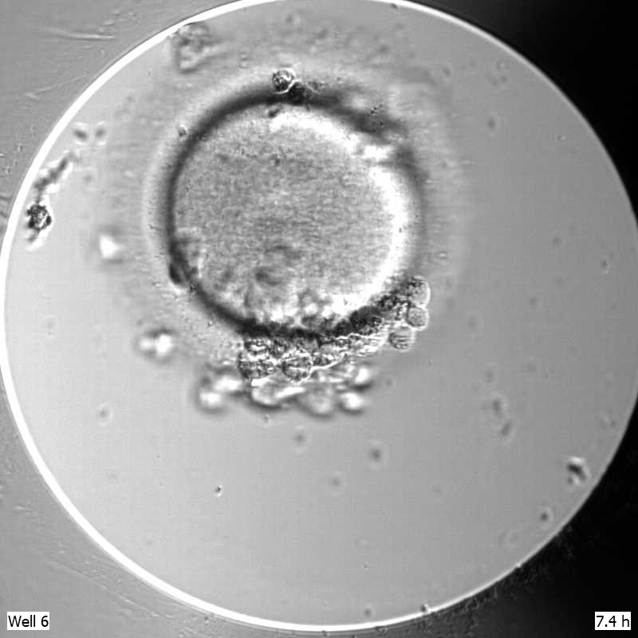
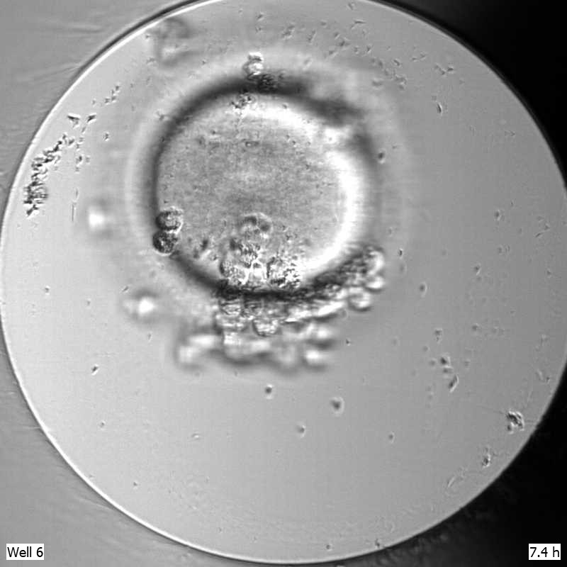
Chapter | colour mode
02
F10
F9
F8
F7
F6
F5
F4
F3
F2
F1
15 µm
F0
15 µm
15 µm

Slide 11
Chapter | colour mode
Run 1
~ 10 minutes
Run 2
~ 10 minutes
F10
Run 3
F9
F10
F8
F9
…
F7
F6
F8
F10
F7
F9
F5
F6
F4
F8
F5
F7
F3
F4
F6
F2
F3
F5
F1
F2
F4
F3
F0
F1
F2
F0
F1
F0

Slide 12
Process | 5 steps
For each run in the selected/available data:
Blur
High-pass filter
Stack 2D data
Create 3D Model
Evaluate
Determine how good the results are based on metrics

Slide 13
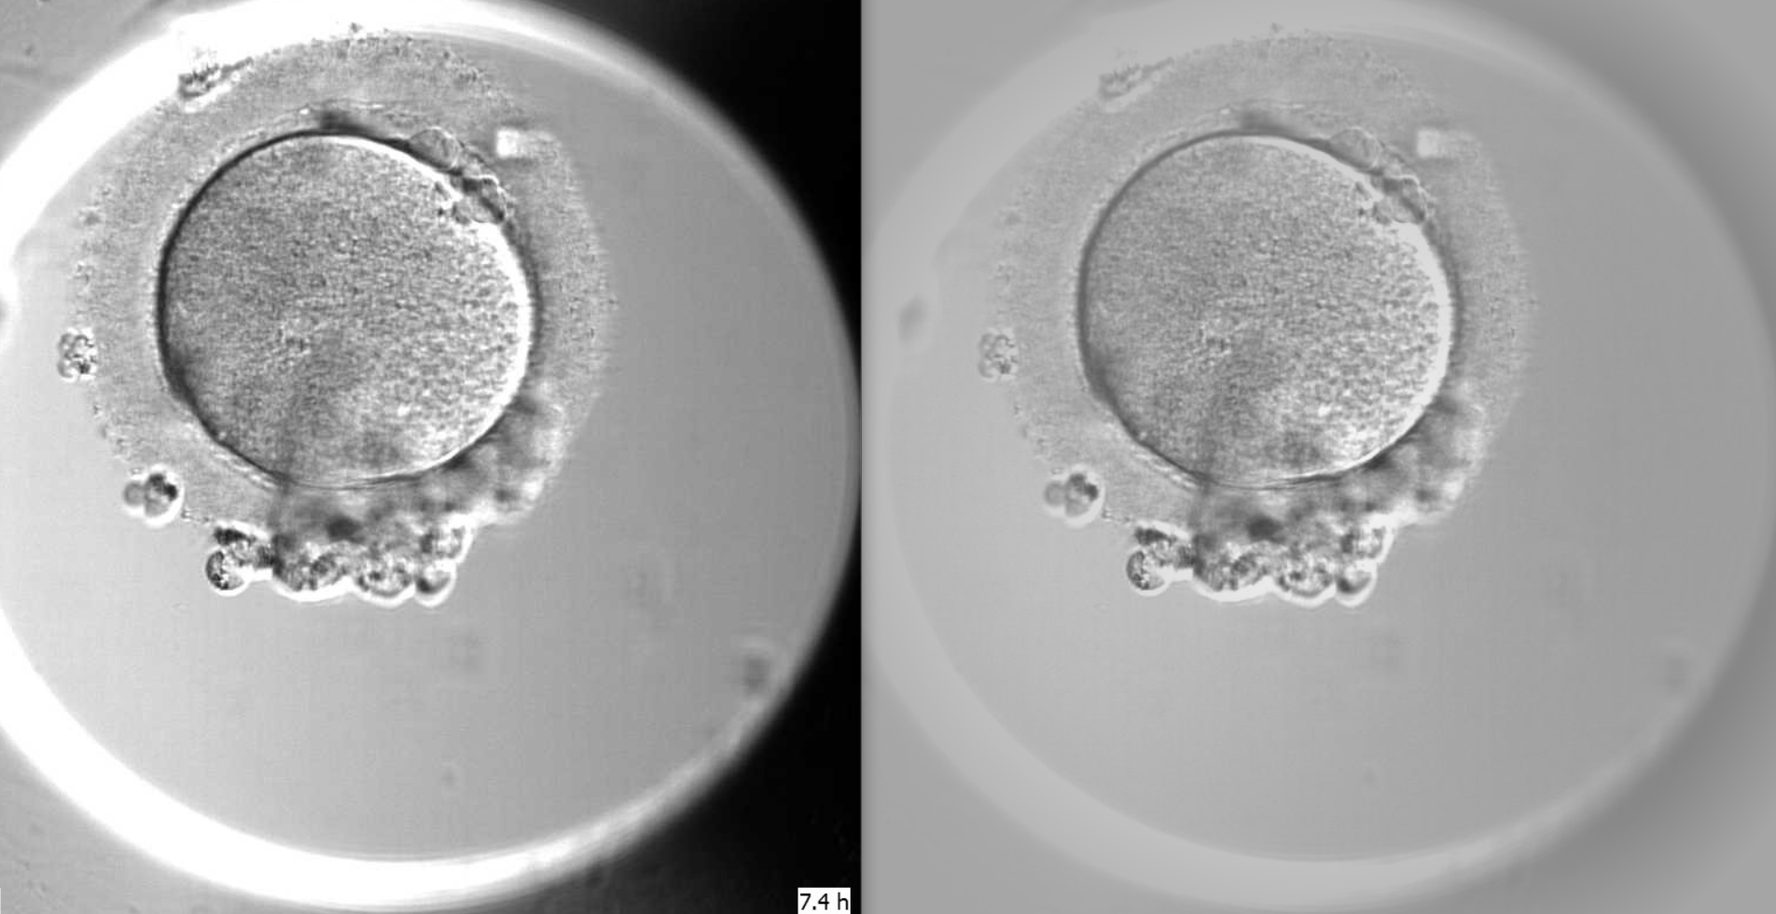
Chapter | colour mode
Step 1 - Blur

Slide 14
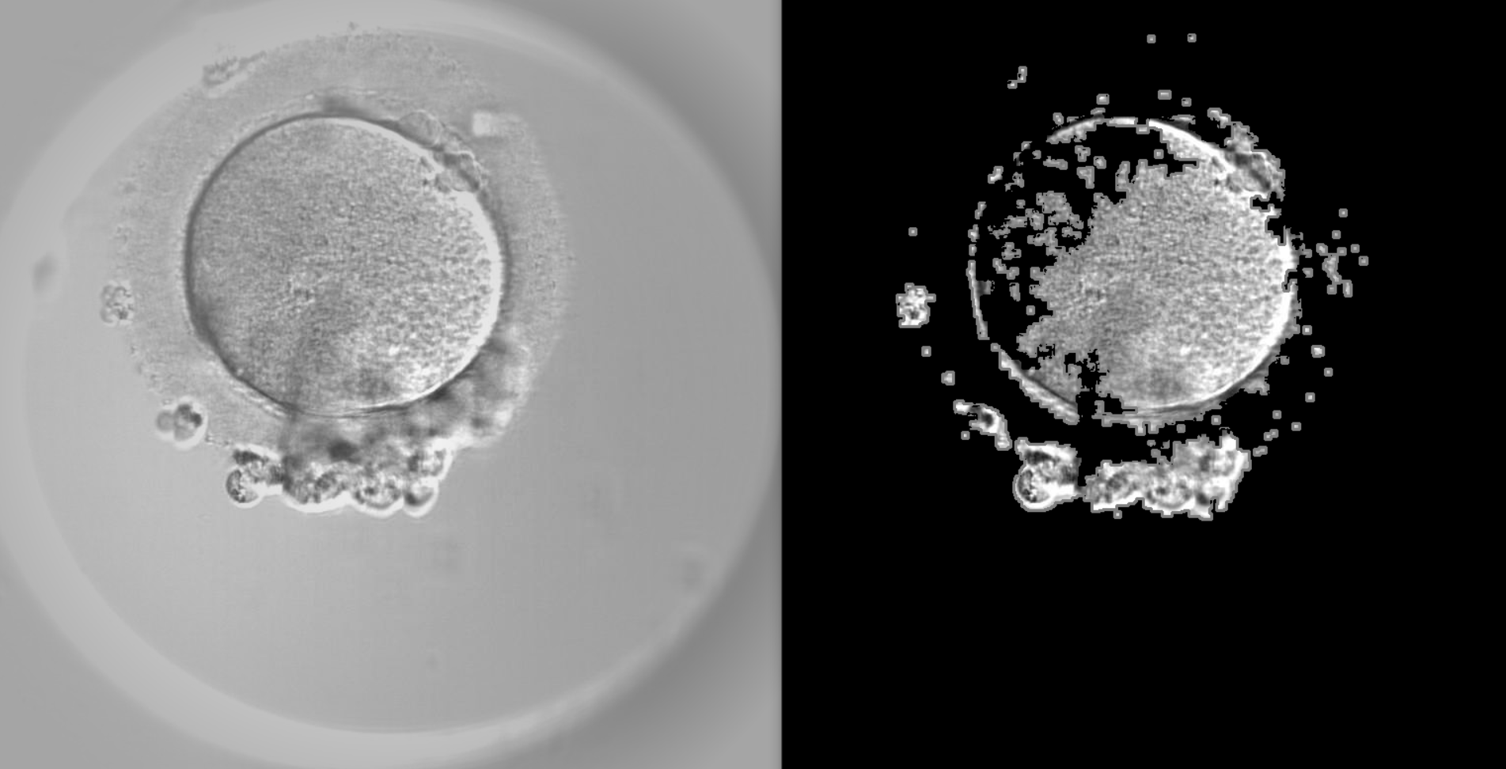
Chapter | colour mode
Step 2 - High-pass filter

Slide 15
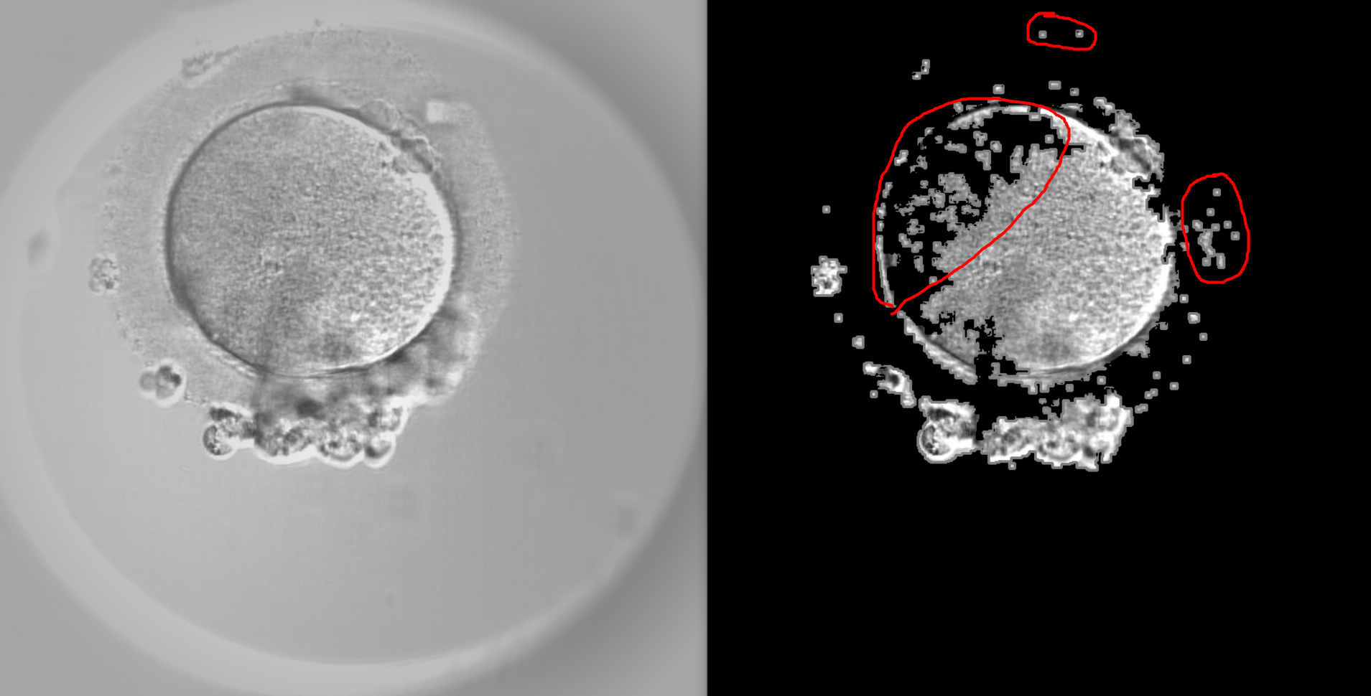
Chapter | colour mode
Step 2 - High-pass filter

Slide 16
Chapter | colour mode
What to do?
Preprocessing and filtering results depend on parameters (kernel sizes, thresholds, etc.)
How to choose the right set?
Quite a few parameters at play…
A lot of combinations…

Slide 17
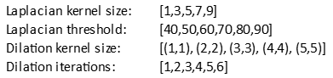
Chapter | colour mode
Pick a subset of parameters to investigate
Consider all possible combinations
= 900 total combinations!
How should we pick one (or a few)?

Slide 18
Process | 5 steps
Let’s explain the metrics!
For each run in the selected/available data:
Blur
High-pass filter
Stack 2D data
Create 3D Model
Evaluate
Determine how good the results are based on metrics

Slide 19
Chapter | colour mode
02
Metrics
Assumptions:
The diameter/volume of the embryo is somewhat consistent over the first few days
Shape is roughly a sphere, volume estimated using V=4/3 * π * r³

Slide 20
Chapter | colour mode
02
Metrics
Model based around consistency within a plausible diameter range of [100-150] µm.
Investigate first 50 runs of data

Slide 21
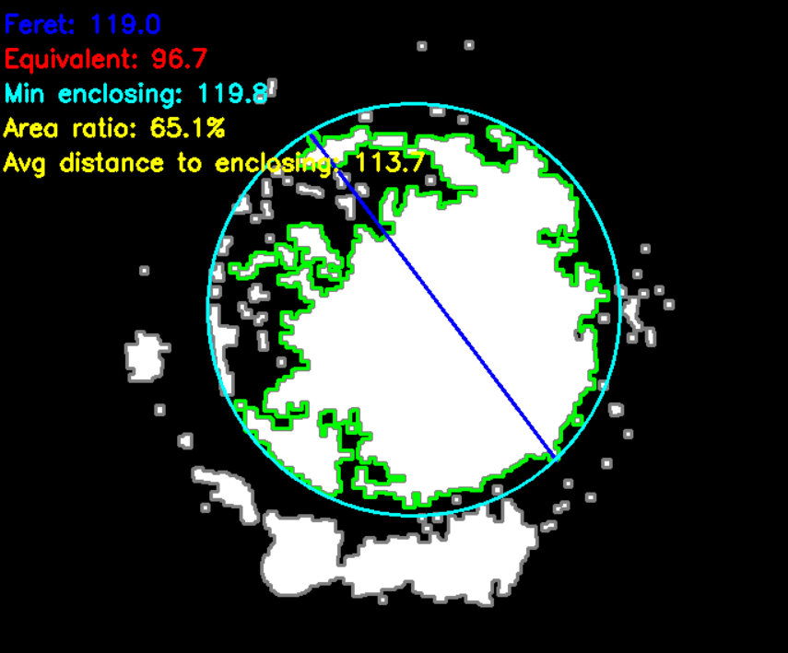
Chapter | colour mode
02
Metrics
Diameter estimation:
Consider middle focal planes
Pick one which provides good area ratio and low average distance
Get diameter of equivalent circle
Reference image including diameter metrics

Slide 22
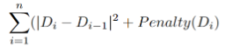
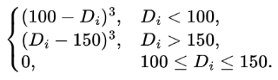
Chapter | colour mode
02
Metrics
First metric: Pairwise difference
Di is the i-th diameter
n = amount of runs (50 in our case)
Objective - minimize sum
Penalty(Di) =

Slide 23
Chapter | colour mode
02
Metrics
Examples:
Good case (low sum):
100, 101, 99, 100, 100.5, 100
Bad case (high sum):
100, 120, 90, 140, 114, 95
Penalty(Di) =

Slide 24
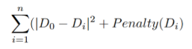
Chapter | colour mode
02
Metrics
Second metric: Deviation from start
Di is the i-th diameter
n = amount of runs (50 in our case)
Objective - minimize sum
Penalty(Di) =

Slide 25
Chapter | colour mode
02
Metrics
Examples:
Good case (low sum):
100, 101, 99, 100, 100.5, 100
Bad case (high sum):
100, 140, 139, 141, 90, 91, 90
Penalty(Di) =

Slide 26
Chapter | colour mode
02
Metrics
We calculate and save the metrics for each of the 900 combinations
 | Pairwise distance sum | Deviation from start sum
Combination 1 | 100 | 25
Combination 2 | 50 | 60
Combination 3 | 70 | 80
…. | … | ...

Slide 27
Chapter | colour mode
02
Metrics
We then multiply the sums by (-1) and apply Min-Max scaling column wise
 | Pairwise distance sum | Deviation from start sum
Combination 1 | -100 | -25
Combination 2 | -50 | -60
Combination 3 | -70 | -80
…. | … | ...

Slide 28
Chapter | colour mode
02
Metrics
After that, we multiply each element by 100 and sum the metrics columns row-wise
 | Pairwise distance | Deviation from start
Combination 1 | 0 | 100
Combination 2 | 100 | 36.36
Combination 3 | 60 | 0
…. | … | ...
100
136.36
60

Slide 29
Chapter | colour mode
02
Metrics
We then sort the results and pick the top k best combinations
C1 100
Sort descendingly
C2 136.36 -> Best combination
C2 136.36
C1 100 -> 2-nd best combination
C3 60
C3 60 -> 3-rd best combination

Slide 30
The actual process | parameter selection
For each of the 900 combinations:
For each run in the selected/available data:
Blur
High-pass filter
Metric sums
Evaluate
Apply gradual blur to outer portions of each focal plane image
Extract areas which are in focus
Add current metric results to respective metric sums
Determine how good the results are based on metrics

Slide 31
The actual process | model production
Using the selected parameters, we can:
Pick top k results
Stack 2D data
Create 3D Model
Evaluate
if needed
Select sets of parameters that provide the best results
Stack all 11 filtered focal planes in a matrix
Feed matrix into Marching Cubes
Eye tests based on results

Slide 32
Chapter | dark mode
Results
03

Slide 33
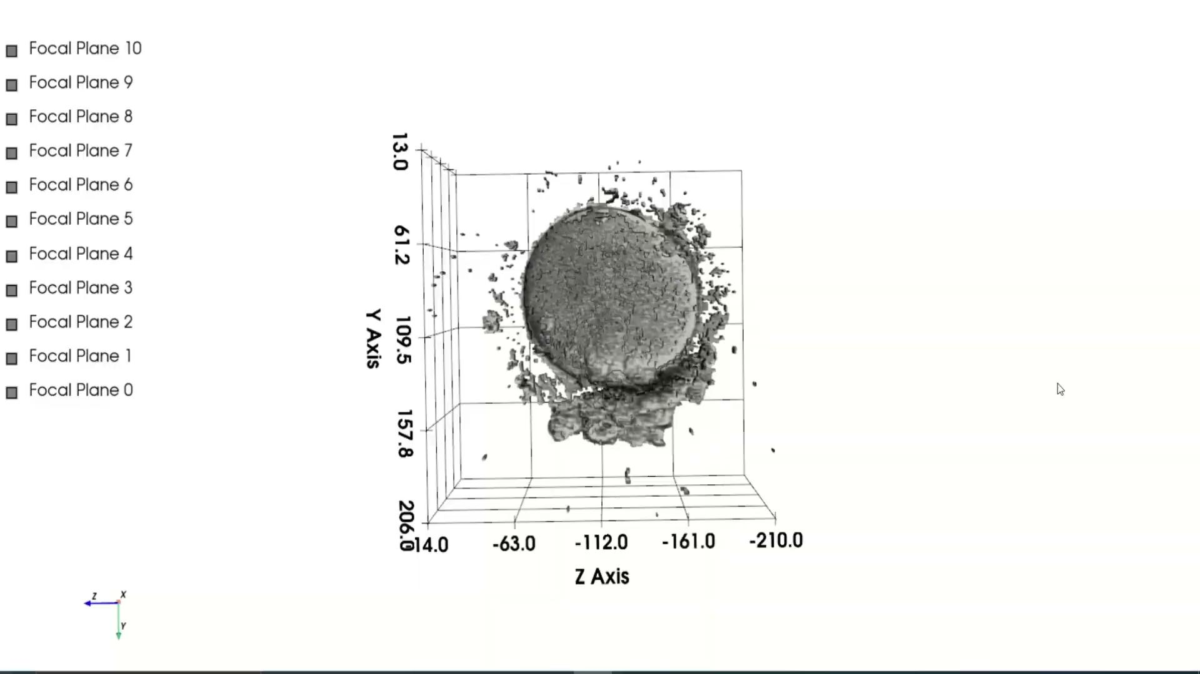
Chapter | colour mode
03
Results
Vid 3.1
Video of the 3D model of the embryo
Fig. 3D model of imaged embryo, showing all focal planes

Slide 34
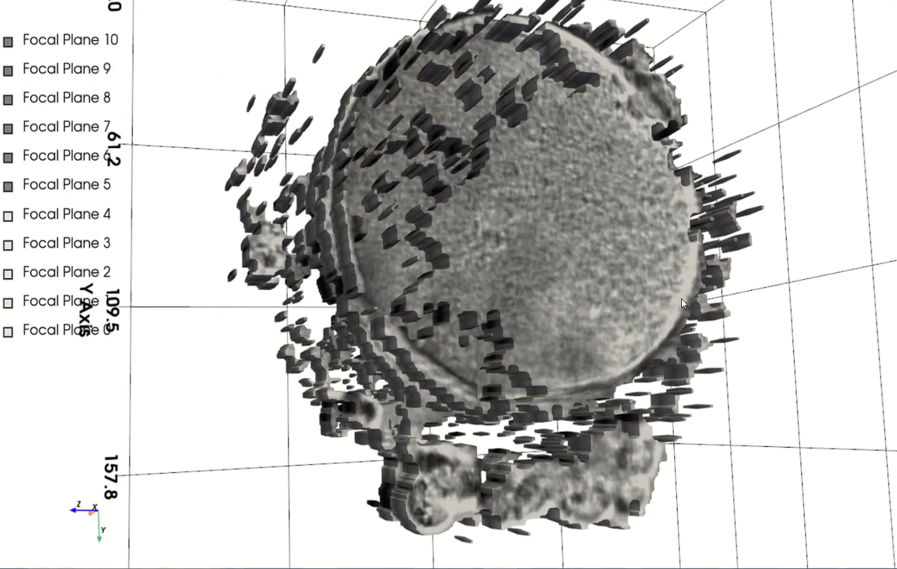
Chapter | colour mode
03
Results
Fig 3.2 Image of middle focal plane of the modeled embryo
Fig 3.1 3D model of imaged embryo, showing six focal planes

Slide 35
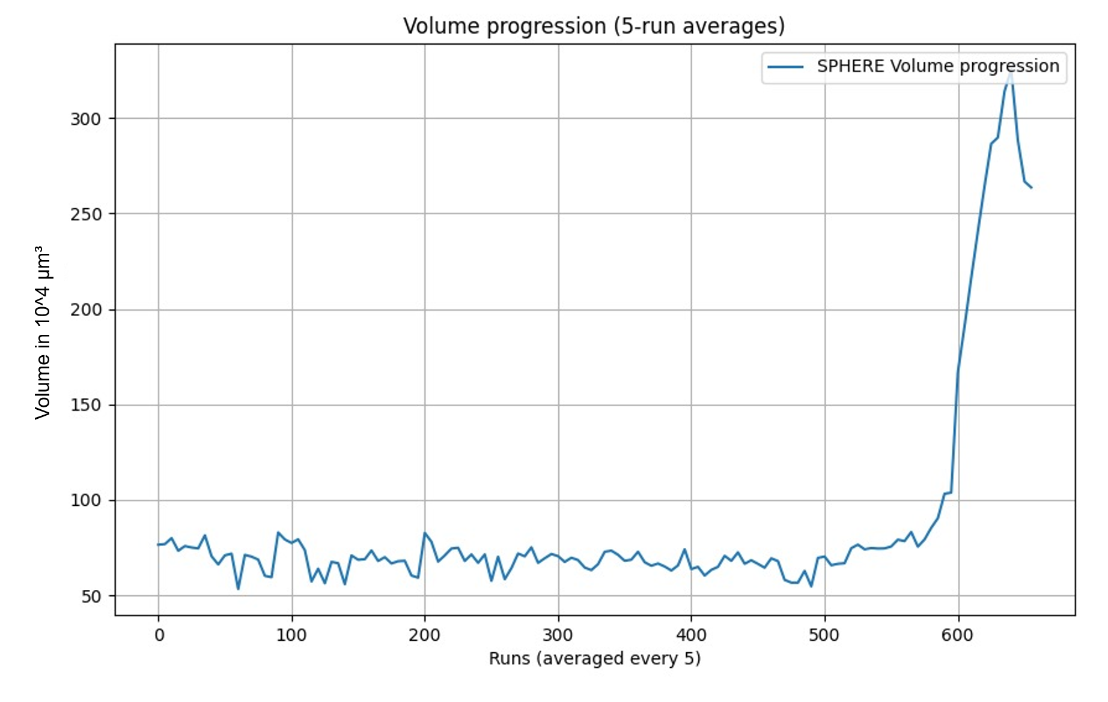
Chapter | colour mode
03
Results
Fig 3.3
Volume Progression of the embryo over five days

Slide 36
Chapter | dark mode
Discussion
04

Slide 37
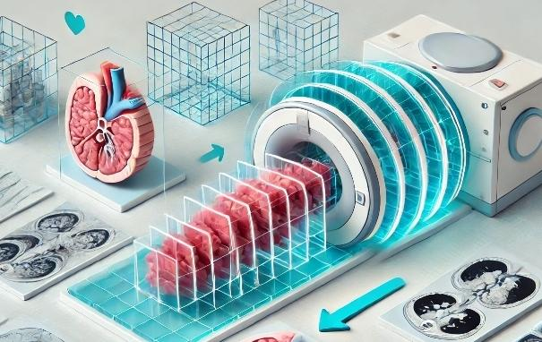
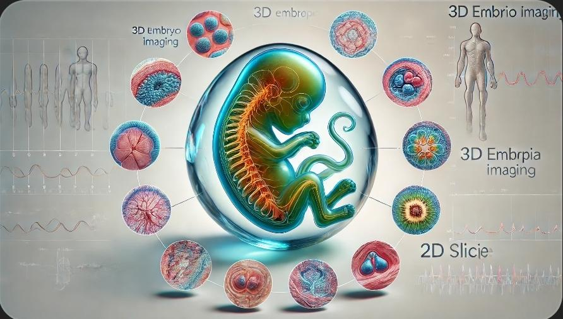
Introduction | 1x
CHOOSING TEXT LEVELS
Home
Algorithmic improvements
Text level down
Text level up
Under the tab ‘Home’, use the list level-buttons to choose a text level. Choose from:
Slice interpolation
1
Bullet
2
Sub-bullet
3
Default text
4
Title/Quote
5
Subtitle
6
Default text
7
Numerical bullet
Different angle slices
8
Alphabetical bullet
9
Source
WANT TO KNOW MORE? Go to the tab 'SLIDEBUILDER’ and click on the button ‘INSPIRATION'
Inspiration

Slide 38
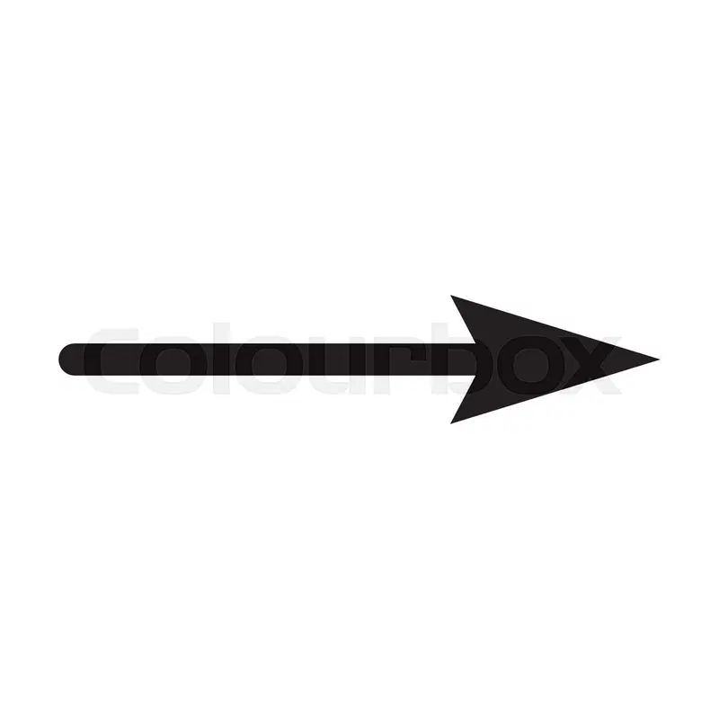

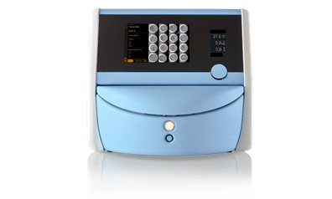
Device improvements

Slide 39
Summary
We have managed to implement a solid 3d model, although with limitations.
Both the device and our algorithm can be improved for better results, which would have a high impact on embryoscopy.

Slide 40
Afsluiter
Thank you for your attention!

